Slide 1


The basics of file systems

Slide 2
The basics of file systems
Consensus in a distributed system
Today we are going to see how to implement a reliable distributed FSM.

Slide 3
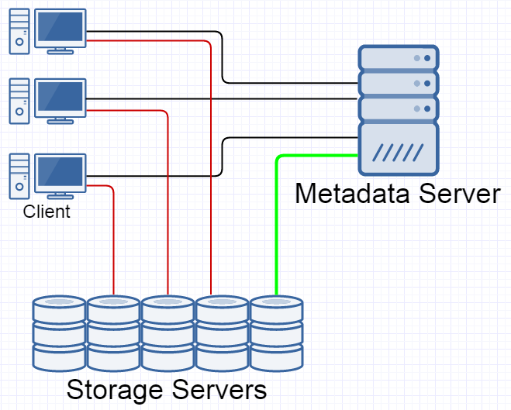
The basics of file systems
A reminder about Parallel NFS
 | When a client opens a file, the metadata server sends it a “file layout”. It describes which storage server contains the file, and what protocol that server uses.

Slide 4
The basics of file systems
A reminder about Parallel NFS
 | When a client opens a file, the metadata server sends it a “file layout”. It describes which storage server contains the file, and what protocol that server uses. Question: how do we handle a client that lost the connection to the metadata server but can still communicate to the storage server? We may not allow two clients to modify the same file without synchronising with each other.

Slide 5
The basics of file systems
A reminder about Parallel NFS
 | When a client opens a file, the metadata server sends it a “file layout”. It describes which storage server contains the file, and what protocol that server uses. Question: how do we handle a client that lost the connection to the metadata server but can still communicate to the storage server? We may not allow two clients to modify the same file without synchronising with each other. A solution by NFSv4.1: the metadata server assigns a layout lease to each file layout. A layout lease has a period when the client may use the layout. If the client does not renew its layout lease, then the storage server stops accepting requests that the stale layout.

Slide 6
The basics of file systems
A reminder about Parallel NFS
 | When a client opens a file, the metadata server sends it a “file layout”. It describes which storage server contains the file, and what protocol that server uses. Question: how do we handle a client that lost the connection to the metadata server but can still communicate to the storage server? We may not allow two clients to modify the same file without synchronising with each other. A solution by NFSv4.1: the metadata server assigns a layout lease to each file layout. A layout lease has a period when the client may use the layout. If the client does not renew its layout lease, then the storage server stops accepting requests that use the stale layout. Quiz: layout lease may not rely on clock of different clients being synchronised. How can we implement that?

Slide 7
The basics of file systems
A reminder about Parallel NFS
 | When a client opens a file, the metadata server sends it a “file layout”. It describes which storage server contains the file, and what protocol that server uses. Quiz: validating layout leases in storage servers appears to be an unnecessary complication. A NFS client may stop issuing requests once its lease time out. Is this right?

Slide 8
The basics of file systems
A reminder about Parallel NFS
 | When a client opens a file, the metadata server sends it a “file layout”. It describes which storage server contains the file, and what protocol that server uses. Quiz: validating layout leases in storage servers appears to be an unnecessary complication. A NFS client may stop issuing requests once its lease time out. Is this right? See also: client fencing.

Slide 9
The basics of file systems
A reminder about Parallel NFS
 | The metadata server is a ”single point of failure” of this system. Question: how can we replicate the state of the metadata server to multiple machines and have them all agree on ”the state” of the metadata server?
X

Slide 10
The basics of file systems
Consensus in a distributed system
Original problem: how to replicate the state of the metadata server to multiple nodes so that all nodes agree on the same state?

Slide 11
The basics of file systems
Consensus in a distributed system
Original problem: how to replicate the state of the metadata server to multiple nodes so that all nodes agree on the same state?
We may regard the metadata server as a deterministic FSM. Its states are FS images, and its state transitions are operations like “create a file”, “delete a file”, etc.

Slide 12
The basics of file systems
Consensus in a distributed system
Original problem: how to replicate the state of the metadata server to multiple nodes so that all nodes agree on the same state?
We may regard the metadata server as a deterministic FSM. Its states are FS images, and its state transitions are operations like “create a file”, “delete a file”, etc. At every step, the replicas of the metadata server need to agree on a state transition that they perform. Every replica must do the same transition.

Slide 13
The basics of file systems
Consensus in a distributed system
Original problem: how to replicate the state of the metadata server to multiple nodes so that all nodes agree on the same state?
We may regard the metadata server as a deterministic FSM. Its states are FS images, and its state transitions are operations like “create a file”, “delete a file”, etc. At every step, the replicas of the metadata server need to agree on a state transition that they perform. Every replica must do the same transition. The state of a deterministic FSM is uniquely defined by a log of state transitions. Thus, to replicate an FSM it suffices to replicate a journal.

Slide 14
The basics of file systems
Consensus in a distributed system
Original problem: how to replicate the state of the metadata server to multiple nodes so that all nodes agree on the same state?
We may regard the metadata server as a deterministic FSM. Its states are FS images, and its state transitions are operations like “create a file”, “delete a file”, etc. At every step, the replicas of the metadata server need to agree on a state transition that they perform. Every replica must do the same transition. The state of a deterministic FSM is uniquely defined by a log of state transitions. Thus, to replicate an FSM it suffices to replicate a journal. To replicate a journal, cluster nodes need to agree on values to append to the log at every step.

Slide 15
The basics of file systems
Consensus in a distributed system
Original problem: how to replicate the state of the metadata server to multiple nodes so that all nodes agree on the same state?
We may regard the metadata server as a deterministic FSM. Its states are FS images, and its state transitions are operations like “create a file”, “delete a file”, etc. At every step, the replicas of the metadata server need to agree on a state transition that they perform. Every replica must do the same transition. The state of a deterministic FSM is uniquely defined by a log of state transitions. Thus, to replicate an FSM it suffices to replicate a journal. To replicate a journal, cluster nodes need to agree on values to append to the log at every step. It suffices to solve the following problem: nodes of a cluster must agree on a value to append to their journals.

Slide 16
The basics of file systems
The problem statement
The original problem: nodes of a cluster must agree on a value to append to a journal.

Slide 17
The basics of file systems
The problem statement
The original problem: nodes of a cluster must agree on a value to append to a journal.
The problem, restated: choose* one value from a set of proposed* values.
* We will define the words “proposed” and “choose” later.

Slide 18
The basics of file systems
The problem statement
The original problem: nodes of a cluster must agree on a value to append to a journal.
The problem, restated: choose* one value from a set of proposed* values. Participants: proposers, acceptors, learners.
* We will define the words “proposed” and “choose” later.

Slide 19
The basics of file systems
The problem statement
The original problem: nodes of a cluster must agree on a value to append to a journal.
The problem, restated: choose* one value from a set of proposed* values. Participants: proposers, acceptors, learners. | Proposer processes send propose() requests. Their arguments are called proposed values. Acceptor processes receive propose() requests from proposers. Acceptor processes send accept() requests to learners. Their arguments are called accepted values. Typically, every cluster member plays all three roles.

Slide 20
The basics of file systems
The problem statement
The original problem: nodes of a cluster must agree on a value to append to a journal.
The problem, restated: choose* one value from a set of proposed* values. Participants: proposers, acceptors, learners. | Proposer processes may be regarded as the source of requests “at step N, create a file F” or “at step N, grant a lease on file F to client C”.

Slide 21
The basics of file systems
The problem statement
The original problem: nodes of a cluster must agree on a value to append to a journal.
The problem, restated: choose* one value from a set of proposed* values. Participants: proposers, acceptors, learners. The model of the network and process failure modes: participant processes may work at arbitrary speed, processes may crash and restart at any moment, messages may be delayed (in particular, reordered), lost, or duplicated, but they cannot be corrupted.

Slide 22
The basics of file systems
Motivation for definitions and rules
We will consider a value chosen if it was accepted by a majority of acceptors.

Slide 23
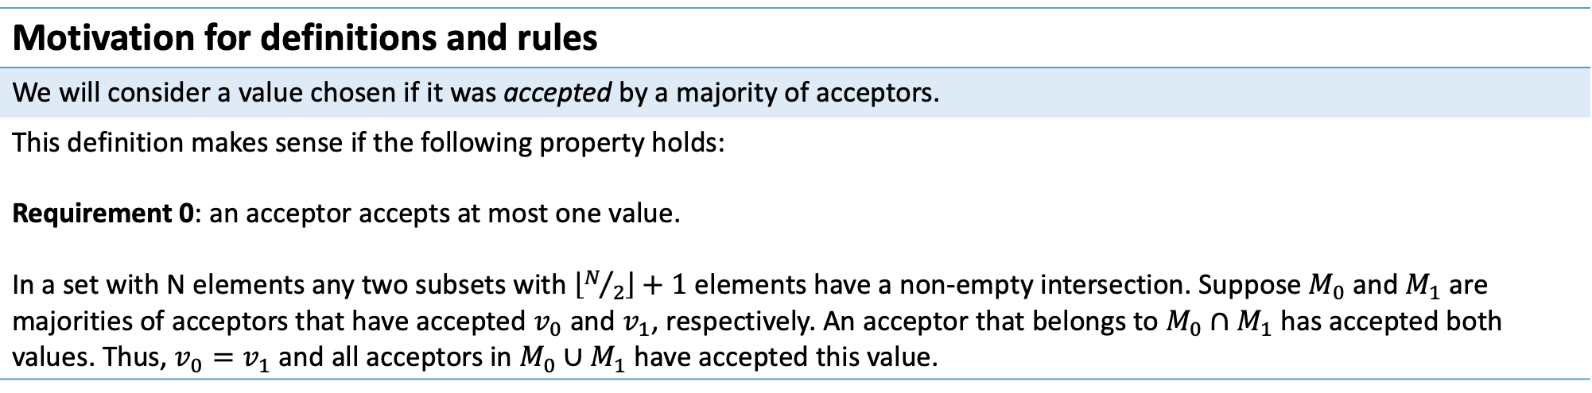
The basics of file systems
Motivation for definitions and rules
We will consider a value chosen if it was accepted by a majority of acceptors.
This definition makes sense if the following property holds: Requirement 0: an acceptor accepts at most one value. In a set with N elements any two subsets with $\left\lfloor N/2\right\rfloor +1$ elements have a non-empty intersection. Suppose $M_{0}$ and $M_{1}$ are majorities of acceptors that have accepted $v_{0}$ and $v_{1}$, respectively. An acceptor that belongs to $M_{0}∩M_{1}$ has accepted both values. Thus, $v_{0}=v_{1}$ and all acceptors in $M_{0}∪M_{1}$ have accepted this value.

Slide 24
The basics of file systems
Motivation for definitions and rules
If only one proposer proposed a value, then this value must be chosen by the system.

Slide 25
The basics of file systems
Motivation for definitions and rules
If only one proposer proposed a value, then this value must be chosen by the system.
In this situation every acceptor receives only one propose() request. Requirement 1: an acceptor must accept the first proposed value.

Slide 26
The basics of file systems
Motivation for definitions and rules
If only one proposer proposed a value, then this value must be chosen by the system.
In this situation every acceptor receives only one propose() request. Requirement 1: an acceptor must accept the first proposed value.
A₀
A₁
A₂
P₀
P₁
P₂
propose(v₀)
propose(v₁)
propose(v₂)

Slide 27
The basics of file systems
Motivation for definitions and rules
If only one proposer proposed a value, then this value must be chosen by the system.
In this situation every acceptor receives only one propose() request. Requirement 1: an acceptor must accept the first proposed value.
A₀
A₁
A₂
P₀
P₁
P₂
In this scenario all acceptors have accepted different values. There can be no majority that accepts the same value.
propose(v₀)
propose(v₁)
propose(v₂)

Slide 28
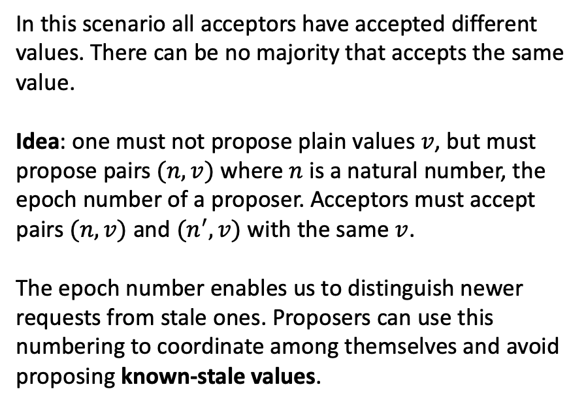
The basics of file systems
Motivation for definitions and rules
If only one proposer proposed a value, then this value must be chosen by the system.
In this situation every acceptor receives only one propose() request. Requirement 1: an acceptor must accept the first proposed value.
A₀
A₁
A₂
P₀
P₁
P₂
In this scenario all acceptors have accepted different values. There can be no majority that accepts the same value.
Idea: one must not propose plain values $v$, but must propose pairs $(n, v)$ where $n$ is a natural number, the epoch number of a proposer. Acceptors must accept pairs $(n, v)$ and $(n^{′}, v)$ with the same $v$.
The epoch number enables us to distinguish newer requests from stale ones. Proposers can use this numbering to coordinate among themselves and avoid proposing known-stale values.
propose(v₀)
propose(v₁)
propose(v₂)

Slide 29
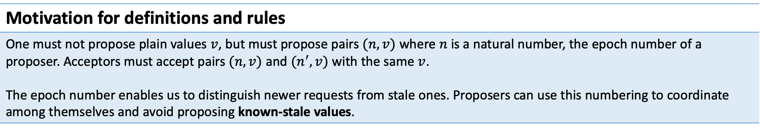
The basics of file systems
Motivation for definitions and rules
One must not propose plain values $v$, but must propose pairs $(n, v)$ where $n$ is a natural number, the epoch number of a proposer. Acceptors must accept pairs $(n, v)$ and $(n^{′}, v)$ with the same $v$. The epoch number enables us to distinguish newer requests from stale ones. Proposers can use this numbering to coordinate among themselves and avoid proposing known-stale values.

Slide 30
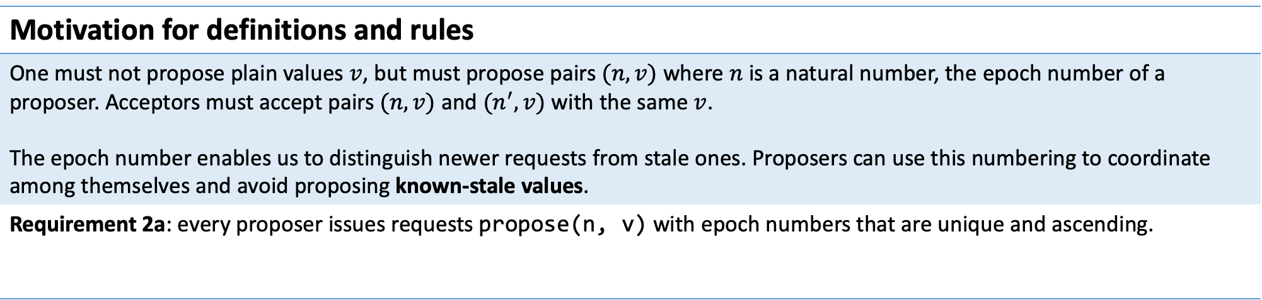
The basics of file systems
Motivation for definitions and rules
One must not propose plain values $v$, but must propose pairs $(n, v)$ where $n$ is a natural number, the epoch number of a proposer. Acceptors must accept pairs $(n, v)$ and $(n^{′}, v)$ with the same $v$. The epoch number enables us to distinguish newer requests from stale ones. Proposers can use this numbering to coordinate among themselves and avoid proposing known-stale values.
Requirement 2a: every proposer issues requests propose(n, v) with epoch numbers that are unique and ascending.

Slide 31
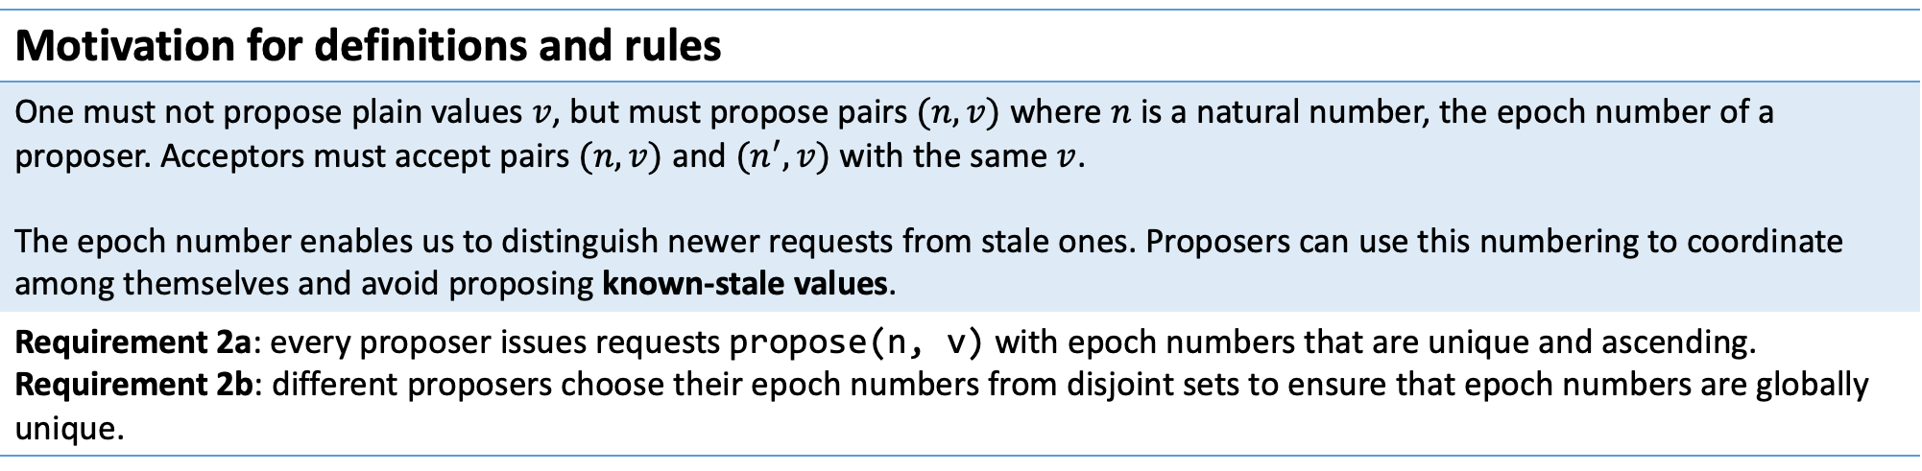
The basics of file systems
Motivation for definitions and rules
One must not propose plain values $v$, but must propose pairs $(n, v)$ where $n$ is a natural number, the epoch number of a proposer. Acceptors must accept pairs $(n, v)$ and $(n^{′}, v)$ with the same $v$. The epoch number enables us to distinguish newer requests from stale ones. Proposers can use this numbering to coordinate among themselves and avoid proposing known-stale values.
Requirement 2a: every proposer issues requests propose(n, v) with epoch numbers that are unique and ascending. Requirement 2b: different proposers choose their epoch numbers from disjoint sets to ensure that epoch numbers are globally unique.
* In a system with N proposers their epochs from sets $\{0, N, 2N, …\}$, $\{1, N+1, 2N+1, …\}$, …

Slide 32
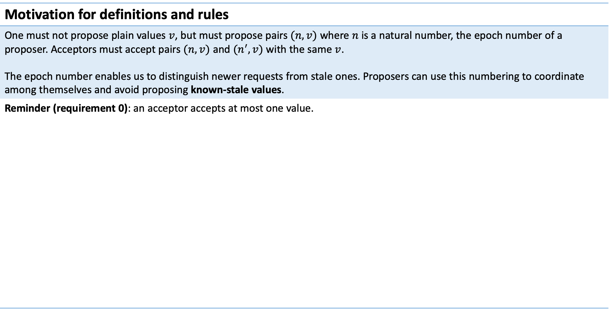
The basics of file systems
Motivation for definitions and rules
One must not propose plain values $v$, but must propose pairs $(n, v)$ where $n$ is a natural number, the epoch number of a proposer. Acceptors must accept pairs $(n, v)$ and $(n^{′}, v)$ with the same $v$. The epoch number enables us to distinguish newer requests from stale ones. Proposers can use this numbering to coordinate among themselves and avoid proposing known-stale values.
Reminder (requirement 0): an acceptor accepts at most one value.

Slide 33
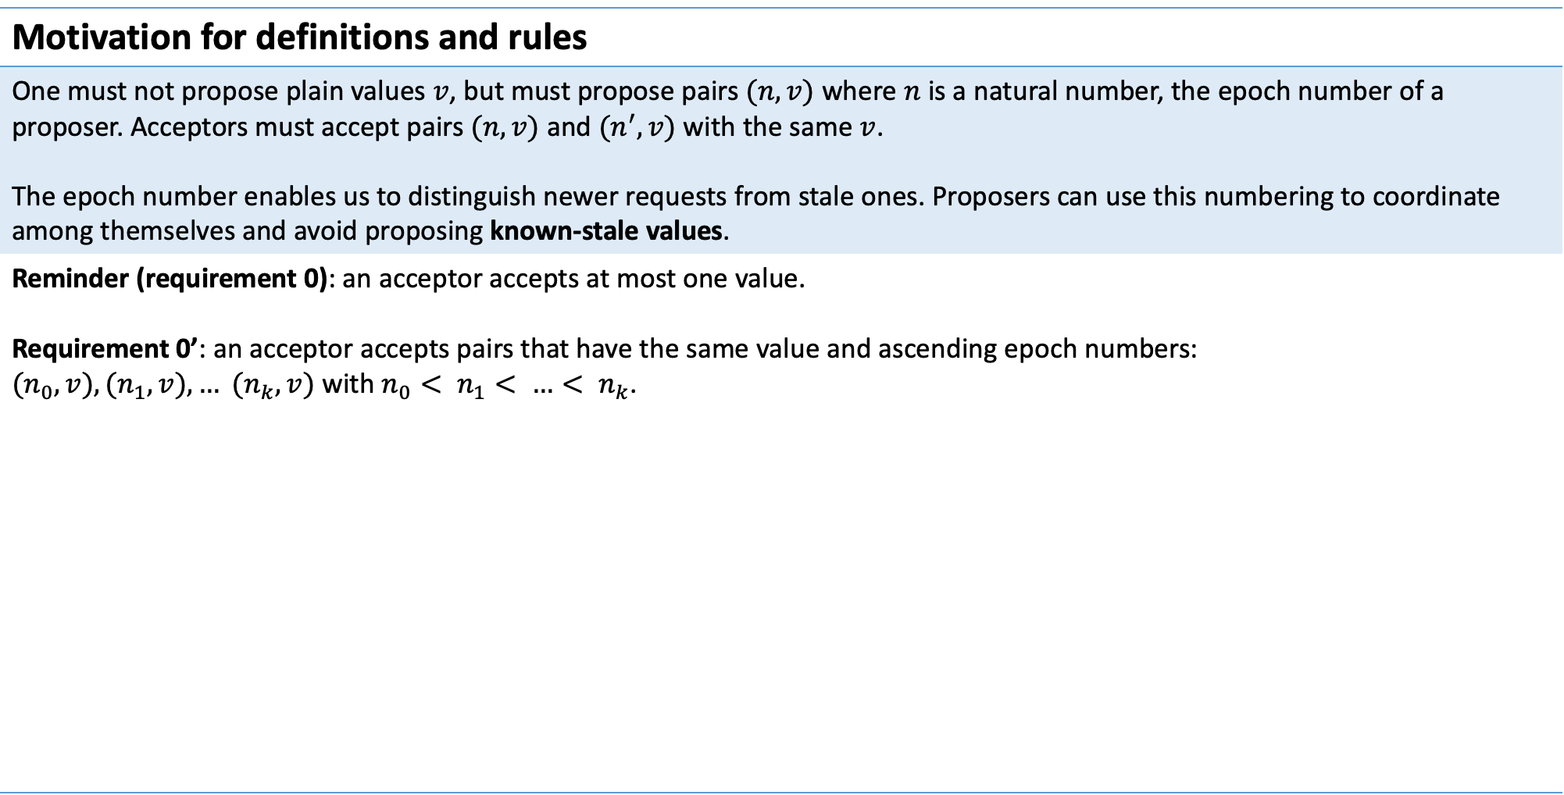
The basics of file systems
Motivation for definitions and rules
One must not propose plain values $v$, but must propose pairs $(n, v)$ where $n$ is a natural number, the epoch number of a proposer. Acceptors must accept pairs $(n, v)$ and $(n^{′}, v)$ with the same $v$. The epoch number enables us to distinguish newer requests from stale ones. Proposers can use this numbering to coordinate among themselves and avoid proposing known-stale values.
Reminder (requirement 0): an acceptor accepts at most one value. Requirement 0’: an acceptor accepts pairs that have the same value and ascending epoch numbers: $(n_{0}, v), (n_{1}, v), … (n_{k}, v)$ with $n_{0}< n_{1}< …< n_{k}$.

Slide 34
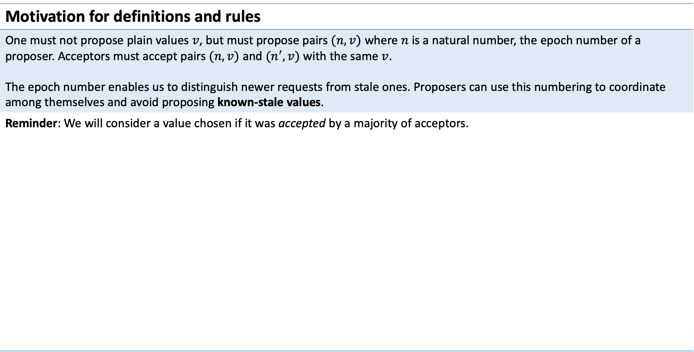
The basics of file systems
Motivation for definitions and rules
One must not propose plain values $v$, but must propose pairs $(n, v)$ where $n$ is a natural number, the epoch number of a proposer. Acceptors must accept pairs $(n, v)$ and $(n^{′}, v)$ with the same $v$. The epoch number enables us to distinguish newer requests from stale ones. Proposers can use this numbering to coordinate among themselves and avoid proposing known-stale values.
Reminder: We will consider a value chosen if it was accepted by a majority of acceptors.

Slide 35

The basics of file systems
Motivation for definitions and rules
One must not propose plain values $v$, but must propose pairs $(n, v)$ where $n$ is a natural number, the epoch number of a proposer. Acceptors must accept pairs $(n, v)$ and $(n^{′}, v)$ with the same $v$. The epoch number enables us to distinguish newer requests from stale ones. Proposers can use this numbering to coordinate among themselves and avoid proposing known-stale values.
Reminder: We will consider a value chosen if it was accepted by a majority of acceptors. Now that we allow acceptors to accept multiple proposals $(n, v)$ and $\left(n^{′}, v\right)$, we must allow situations where a majority of acceptors have accepted pairs $\{\left(n_{i}, v\right)\}$ with different epochs. We only need to require that all accepted pairs have the same value $v$.

Slide 36
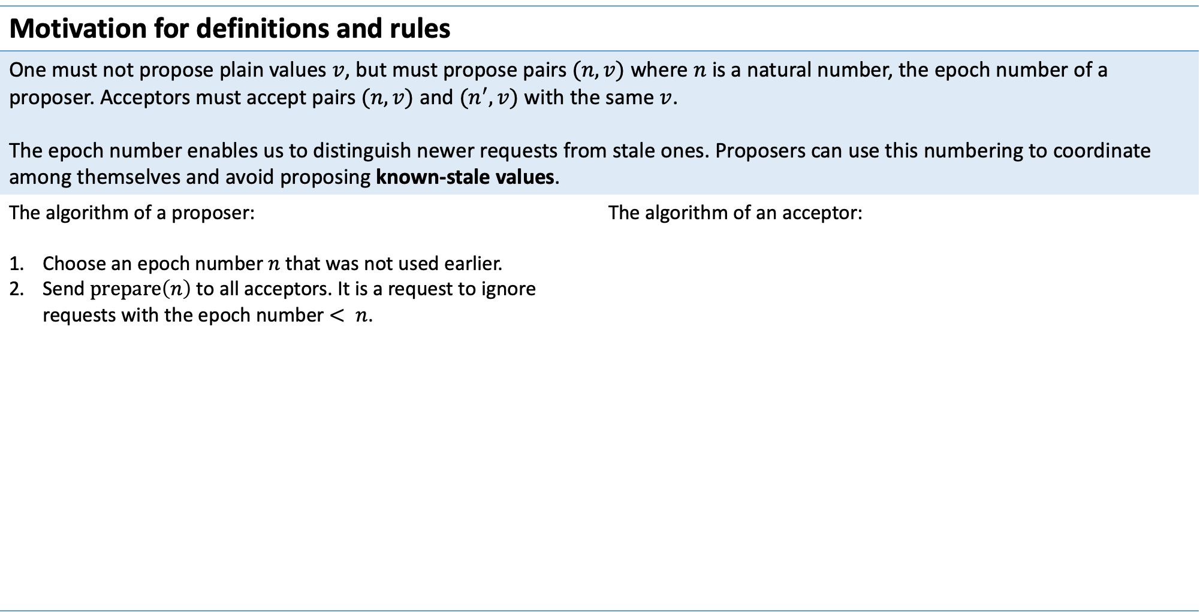
The basics of file systems
Motivation for definitions and rules
One must not propose plain values $v$, but must propose pairs $(n, v)$ where $n$ is a natural number, the epoch number of a proposer. Acceptors must accept pairs $(n, v)$ and $(n^{′}, v)$ with the same $v$. The epoch number enables us to distinguish newer requests from stale ones. Proposers can use this numbering to coordinate among themselves and avoid proposing known-stale values.
The algorithm of a proposer: Choose an epoch number $n$ that was not used earlier. Send $\operatorname{prepare}\left(n\right)$ to all acceptors. It is a request to ignore requests with the epoch number $< n$. | The algorithm of an acceptor:

Slide 37
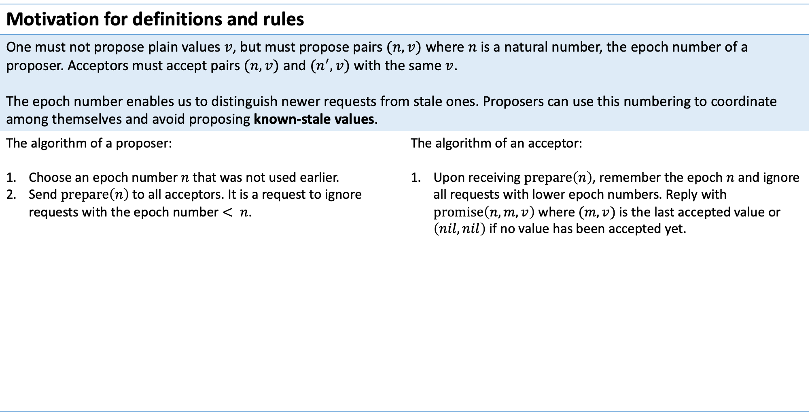
The basics of file systems
Motivation for definitions and rules
One must not propose plain values $v$, but must propose pairs $(n, v)$ where $n$ is a natural number, the epoch number of a proposer. Acceptors must accept pairs $(n, v)$ and $(n^{′}, v)$ with the same $v$. The epoch number enables us to distinguish newer requests from stale ones. Proposers can use this numbering to coordinate among themselves and avoid proposing known-stale values.
The algorithm of a proposer: Choose an epoch number $n$ that was not used earlier. Send $\operatorname{prepare}\left(n\right)$ to all acceptors. It is a request to ignore requests with the epoch number $< n$. | The algorithm of an acceptor: Upon receiving $\operatorname{prepare}\left(n\right)$, remember the epoch $n$ and ignore all requests with lower epoch numbers. Reply with $\operatorname{promise}\left(n, m, v\right)$ where $(m, v)$ is the last accepted value or $\left(nil, nil\right)$ if no value has been accepted yet.

Slide 38
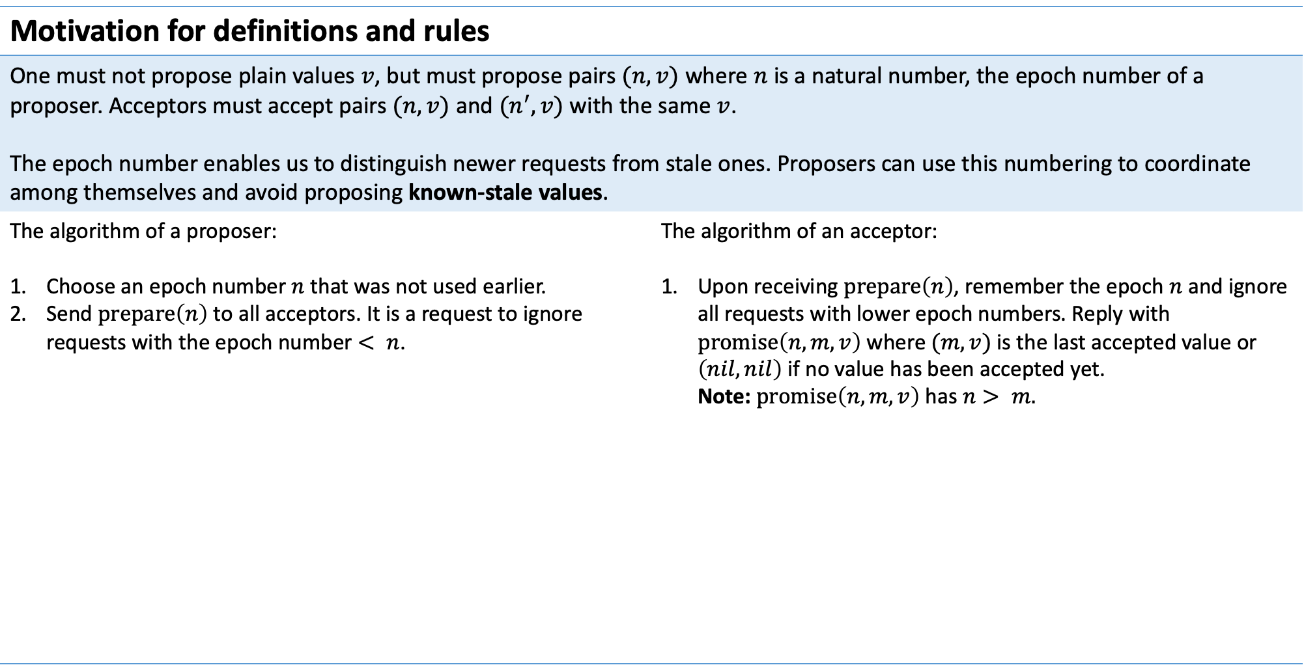
The basics of file systems
Motivation for definitions and rules
One must not propose plain values $v$, but must propose pairs $(n, v)$ where $n$ is a natural number, the epoch number of a proposer. Acceptors must accept pairs $(n, v)$ and $(n^{′}, v)$ with the same $v$. The epoch number enables us to distinguish newer requests from stale ones. Proposers can use this numbering to coordinate among themselves and avoid proposing known-stale values.
The algorithm of a proposer: Choose an epoch number $n$ that was not used earlier. Send $\operatorname{prepare}\left(n\right)$ to all acceptors. It is a request to ignore requests with the epoch number $< n$. | The algorithm of an acceptor: Upon receiving $\operatorname{prepare}\left(n\right)$, remember the epoch $n$ and ignore all requests with lower epoch numbers. Reply with $\operatorname{promise}\left(n, m, v\right)$ where $(m, v)$ is the last accepted value or $\left(nil, nil\right)$ if no value has been accepted yet. Note: $\operatorname{promise}\left(n, m, v\right)$ has $n> m.$

Slide 39
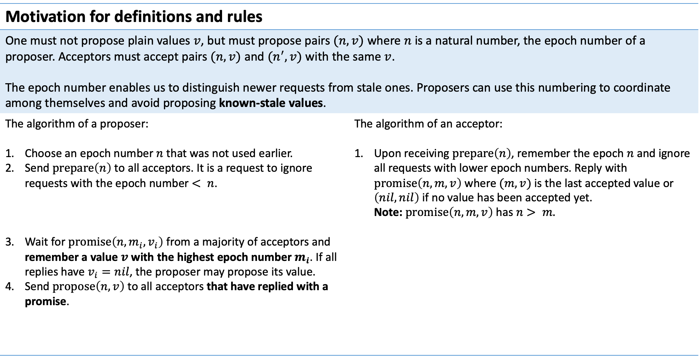
The basics of file systems
Motivation for definitions and rules
One must not propose plain values $v$, but must propose pairs $(n, v)$ where $n$ is a natural number, the epoch number of a proposer. Acceptors must accept pairs $(n, v)$ and $(n^{′}, v)$ with the same $v$. The epoch number enables us to distinguish newer requests from stale ones. Proposers can use this numbering to coordinate among themselves and avoid proposing known-stale values.
The algorithm of a proposer: Choose an epoch number $n$ that was not used earlier. Send $\operatorname{prepare}\left(n\right)$ to all acceptors. It is a request to ignore requests with the epoch number $< n$. Wait for $\operatorname{promise}\left(n, m_{i}, v_{i}\right)$ from a majority of acceptors and remember a value $v$ with the highest epoch number $m_{i}$. If all replies have $v_{i}=nil$, the proposer may propose its value. Send $\operatorname{propose}\left(n, v\right)$ to all acceptors that have replied with a promise. | The algorithm of an acceptor: Upon receiving $\operatorname{prepare}\left(n\right)$, remember the epoch $n$ and ignore all requests with lower epoch numbers. Reply with $\operatorname{promise}\left(n, m, v\right)$ where $(m, v)$ is the last accepted value or $\left(nil, nil\right)$ if no value has been accepted yet. Note: $\operatorname{promise}\left(n, m, v\right)$ has $n> m.$

Slide 40
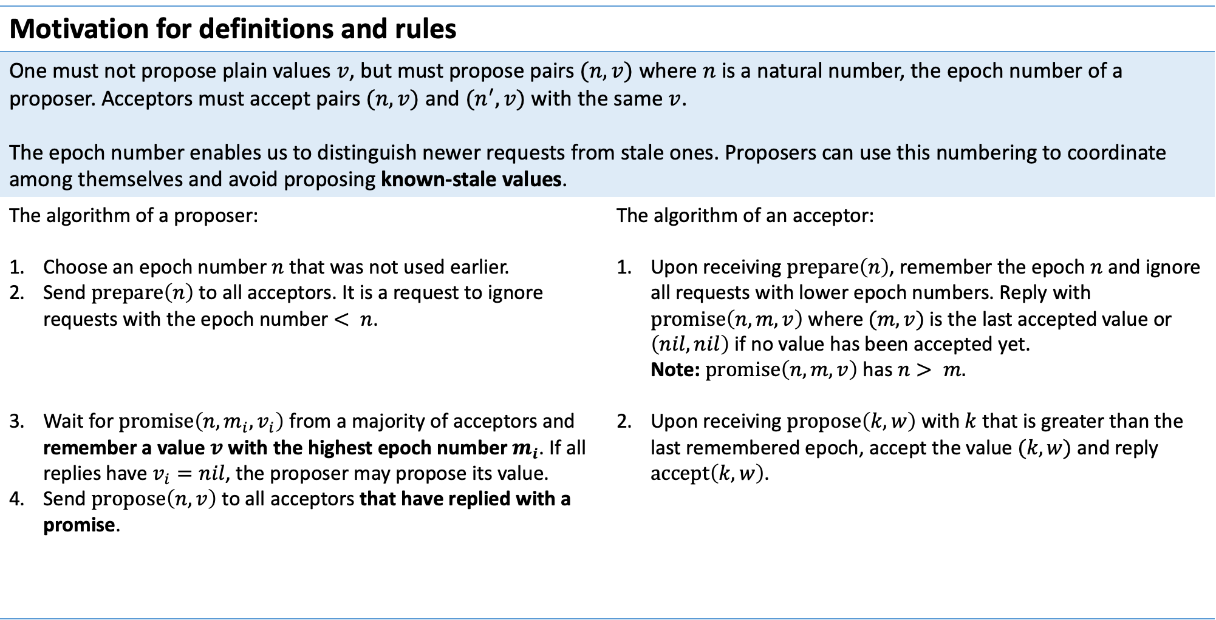
The basics of file systems
Motivation for definitions and rules
One must not propose plain values $v$, but must propose pairs $(n, v)$ where $n$ is a natural number, the epoch number of a proposer. Acceptors must accept pairs $(n, v)$ and $(n^{′}, v)$ with the same $v$. The epoch number enables us to distinguish newer requests from stale ones. Proposers can use this numbering to coordinate among themselves and avoid proposing known-stale values.
The algorithm of a proposer: Choose an epoch number $n$ that was not used earlier. Send $\operatorname{prepare}\left(n\right)$ to all acceptors. It is a request to ignore requests with the epoch number $< n$. Wait for $\operatorname{promise}\left(n, m_{i}, v_{i}\right)$ from a majority of acceptors and remember a value $v$ with the highest epoch number $m_{i}$. If all replies have $v_{i}=nil$, the proposer may propose its value. Send $\operatorname{propose}\left(n, v\right)$ to all acceptors that have replied with a promise. | The algorithm of an acceptor: Upon receiving $\operatorname{prepare}\left(n\right)$, remember the epoch $n$ and ignore all requests with lower epoch numbers. Reply with $\operatorname{promise}\left(n, m, v\right)$ where $(m, v)$ is the last accepted value or $\left(nil, nil\right)$ if no value has been accepted yet. Note: $\operatorname{promise}\left(n, m, v\right)$ has $n> m.$ Upon receiving $\operatorname{propose}\left(k, w\right)$ with $k$ that is greater than the last remembered epoch, accept the value $(k, w)$ and reply $\operatorname{accept}\left(k, w\right)$.

Slide 41
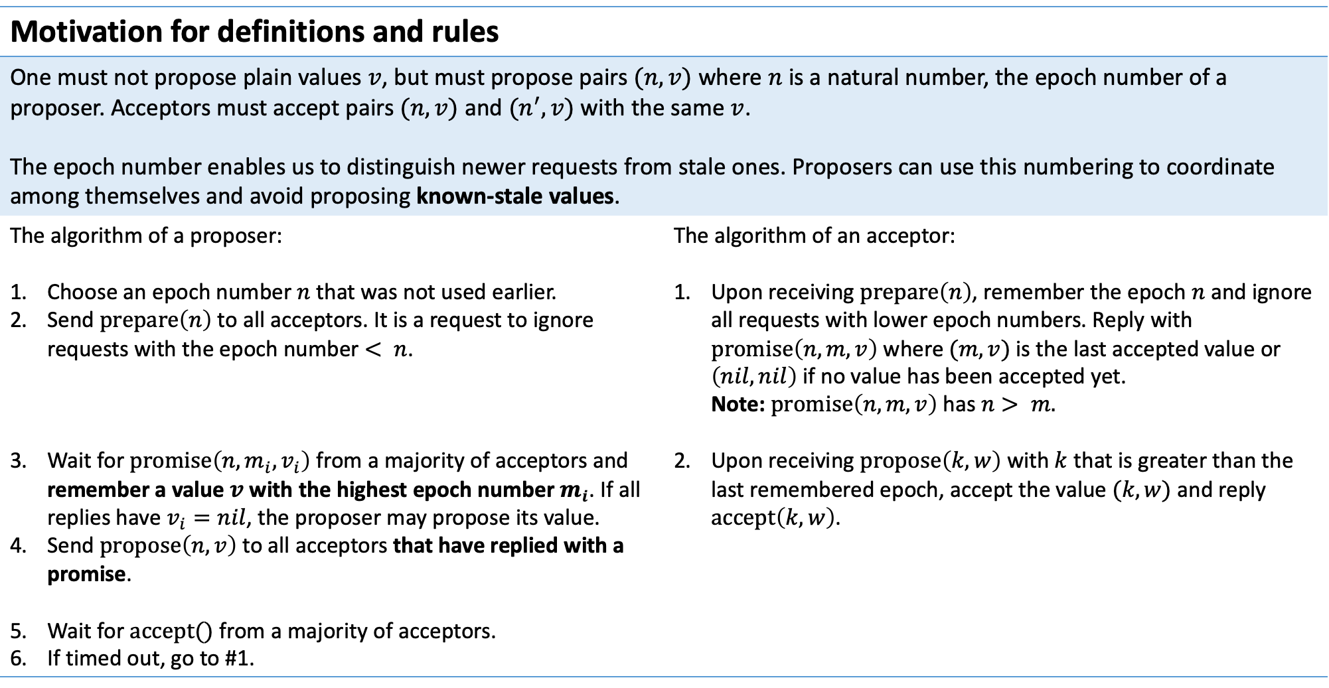
The basics of file systems
Motivation for definitions and rules
One must not propose plain values $v$, but must propose pairs $(n, v)$ where $n$ is a natural number, the epoch number of a proposer. Acceptors must accept pairs $(n, v)$ and $(n^{′}, v)$ with the same $v$. The epoch number enables us to distinguish newer requests from stale ones. Proposers can use this numbering to coordinate among themselves and avoid proposing known-stale values.
The algorithm of a proposer: Choose an epoch number $n$ that was not used earlier. Send $\operatorname{prepare}\left(n\right)$ to all acceptors. It is a request to ignore requests with the epoch number $< n$. Wait for $\operatorname{promise}\left(n, m_{i}, v_{i}\right)$ from a majority of acceptors and remember a value $v$ with the highest epoch number $m_{i}$. If all replies have $v_{i}=nil$, the proposer may propose its value. Send $\operatorname{propose}\left(n, v\right)$ to all acceptors that have replied with a promise. Wait for $accept()$ from a majority of acceptors. If timed out, go to #1. | The algorithm of an acceptor: Upon receiving $\operatorname{prepare}\left(n\right)$, remember the epoch $n$ and ignore all requests with lower epoch numbers. Reply with $\operatorname{promise}\left(n, m, v\right)$ where $(m, v)$ is the last accepted value or $\left(nil, nil\right)$ if no value has been accepted yet. Note: $\operatorname{promise}\left(n, m, v\right)$ has $n> m.$ Upon receiving $\operatorname{propose}\left(k, w\right)$ with $k$ that is greater than the last remembered epoch, accept the value $(k, w)$ and reply $\operatorname{accept}\left(k, w\right)$.

Slide 42
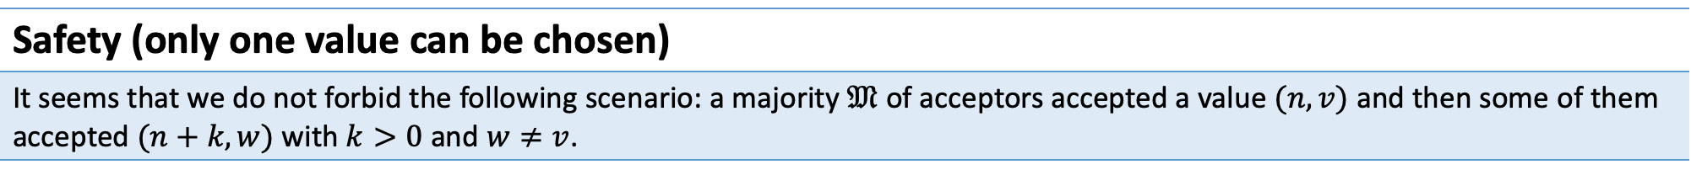
The basics of file systems
Safety (only one value can be chosen)
It seems that we do not forbid the following scenario: a majority $𝔐$ of acceptors accepted a value $(n, v)$ and then some of them accepted $(n+k, w)$ with $k>0$ and $w≠v$.

Slide 43
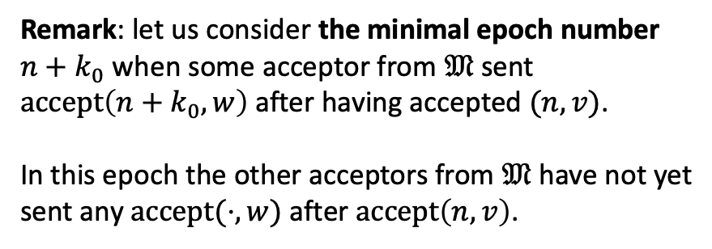
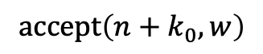
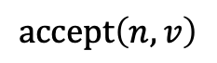
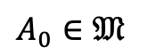
The basics of file systems
Safety (only one value can be chosen)
It seems that we do not forbid the following scenario: a majority $𝔐$ of acceptors accepted a value $(n, v)$ and then some of them accepted $(n+k, w)$ with $k>0$ and $w≠v$.
$$A_{0}∈𝔐$$
Remark: let us consider the minimal epoch number $n+k_{0}$ when some acceptor from $𝔐$ sent $\operatorname{accept}\left(n+k_{0}, w\right)$ after having accepted $(n, v)$. In this epoch the other acceptors from $𝔐$ have not yet sent any $accept(⋅, w)$ after $\operatorname{accept}\left(n, v\right)$.
$$\operatorname{accept}\left(n, v\right)$$
$$\operatorname{accept}\left(n+k_{0}, w\right)$$

Slide 44
The basics of file systems
Safety (only one value can be chosen)
It seems that we do not forbid the following scenario: a majority $𝔐$ of acceptors accepted a value $(n, v)$ and then some of them accepted $(n+k, w)$ with $k>0$ and $w≠v$.
$$A_{0}∈𝔐$$
P
$$\operatorname{accept}\left(n, v\right)$$
$$\operatorname{accept}\left(n+k_{0}, w\right)$$

Slide 45
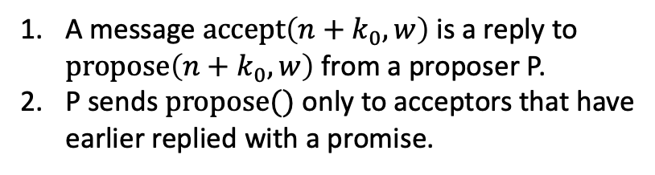
The basics of file systems
Safety (only one value can be chosen)
It seems that we do not forbid the following scenario: a majority $𝔐$ of acceptors accepted a value $(n, v)$ and then some of them accepted $(n+k, w)$ with $k>0$ and $w≠v$.
$$A_{0}∈𝔐$$
P
A message $\operatorname{accept}\left(n+k_{0}, w\right)$ is a reply to $\operatorname{propose}\left(n+k_{0}, w\right)$ from a proposer P.
P sends $propose()$ only to acceptors that have earlier replied with a promise.
$$\operatorname{accept}\left(n, v\right)$$
$$\operatorname{accept}\left(n+k_{0}, w\right)$$

Slide 46
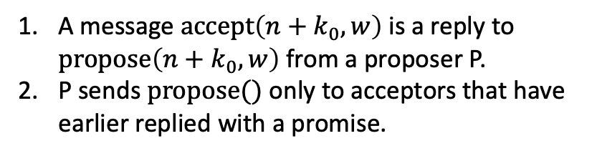
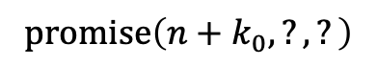
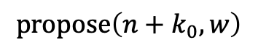
The basics of file systems
Safety (only one value can be chosen)
It seems that we do not forbid the following scenario: a majority $𝔐$ of acceptors accepted a value $(n, v)$ and then some of them accepted $(n+k, w)$ with $k>0$ and $w≠v$.
$$A_{0}∈𝔐$$
P
A message $\operatorname{accept}\left(n+k_{0}, w\right)$ is a reply to $\operatorname{propose}\left(n+k_{0}, w\right)$ from a proposer P.
P sends $propose()$ only to acceptors that have earlier replied with a promise.
$$\operatorname{accept}\left(n, v\right)$$
$$\operatorname{promise}\left(n+k_{0}, ?, ?\right)$$
$$\operatorname{propose}\left(n+k_{0}, w\right)$$
$$\operatorname{accept}\left(n+k_{0}, w\right)$$

Slide 47
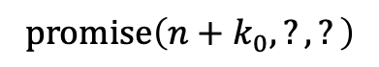
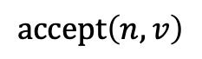
The basics of file systems
Safety (only one value can be chosen)
It seems that we do not forbid the following scenario: a majority $𝔐$ of acceptors accepted a value $(n, v)$ and then some of them accepted $(n+k, w)$ with $k>0$ and $w≠v$.
$$A_{0}∈𝔐$$
P
A message $\operatorname{accept}\left(n+k_{0}, w\right)$ is a reply to $\operatorname{propose}\left(n+k_{0}, w\right)$ from a proposer P.
P sends $propose()$ only to acceptors that have earlier replied with a promise.
Can the messages be ordered this way?
$$\operatorname{promise}\left(n+k_{0}, ?, ?\right)$$
$$\operatorname{accept}\left(n, v\right)$$
$$\operatorname{propose}\left(n+k_{0}, w\right)$$
$$\operatorname{accept}\left(n+k_{0}, w\right)$$

Slide 48
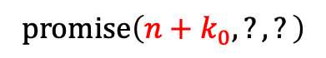
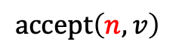
The basics of file systems
Safety (only one value can be chosen)
It seems that we do not forbid the following scenario: a majority $𝔐$ of acceptors accepted a value $(n, v)$ and then some of them accepted $(n+k, w)$ with $k>0$ and $w≠v$.
$$A_{0}∈𝔐$$
P
A message $\operatorname{accept}\left(n+k_{0}, w\right)$ is a reply to $\operatorname{propose}\left(n+k_{0}, w\right)$ from a proposer P.
P sends $propose()$ only to acceptors that have earlier replied with a promise.
Can the messages be ordered this way?
$$\operatorname{promise}\left(n+k_{0}, ?, ?\right)$$
$$\operatorname{accept}\left(n, v\right)$$
$$\operatorname{propose}\left(n+k_{0}, w\right)$$
$$\operatorname{accept}\left(n+k_{0}, w\right)$$

Slide 49
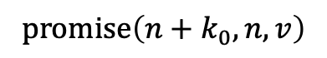
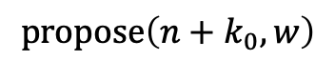
The basics of file systems
Safety (only one value can be chosen)
It seems that we do not forbid the following scenario: a majority $𝔐$ of acceptors accepted a value $(n, v)$ and then some of them accepted $(n+k, w)$ with $k>0$ and $w≠v$.
$$A_{0}∈𝔐$$
P
A message $\operatorname{accept}\left(n+k_{0}, w\right)$ is a reply to $\operatorname{propose}\left(n+k_{0}, w\right)$ from a proposer P.
P sends $propose()$ only to acceptors that have earlier replied with a promise.
$$\operatorname{accept}\left(n, v\right)$$
$$\operatorname{promise}\left(n+k_{0}, n, v\right)$$
$$\operatorname{propose}\left(n+k_{0}, w\right)$$
$$\operatorname{accept}\left(n+k_{0}, w\right)$$

Slide 50
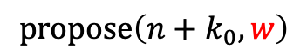
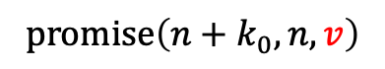
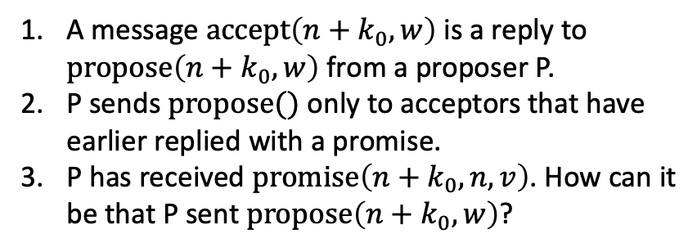
The basics of file systems
Safety (only one value can be chosen)
It seems that we do not forbid the following scenario: a majority $𝔐$ of acceptors accepted a value $(n, v)$ and then some of them accepted $(n+k, w)$ with $k>0$ and $w≠v$.
$$A_{0}∈𝔐$$
P
A message $\operatorname{accept}\left(n+k_{0}, w\right)$ is a reply to $\operatorname{propose}\left(n+k_{0}, w\right)$ from a proposer P.
P sends $propose()$ only to acceptors that have earlier replied with a promise.
P has received $\operatorname{promise}\left(n+k_{0}, n, v\right)$. How can it be that P sent $\operatorname{propose}\left(n+k_{0}, w\right)$?
$$\operatorname{accept}\left(n, v\right)$$
$$\operatorname{promise}\left(n+k_{0}, n, v\right)$$
$$\operatorname{propose}\left(n+k_{0}, w\right)$$
$$\operatorname{accept}\left(n+k_{0}, w\right)$$

Slide 51
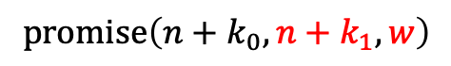
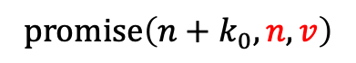
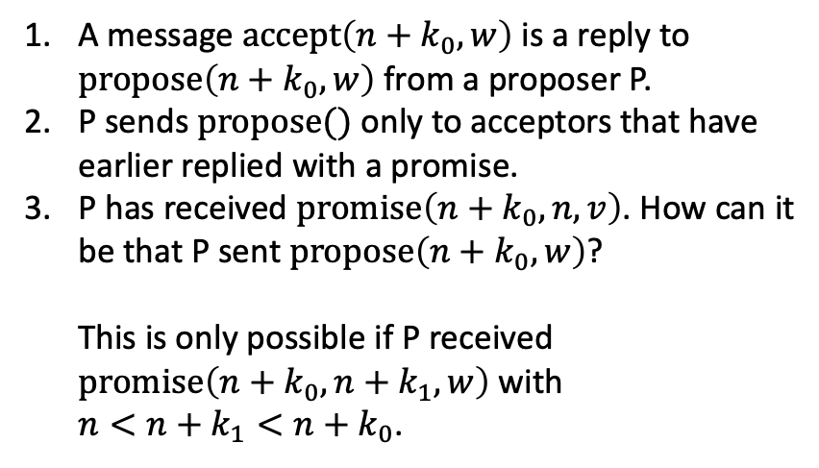
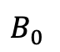
The basics of file systems
Safety (only one value can be chosen)
It seems that we do not forbid the following scenario: a majority $𝔐$ of acceptors accepted a value $(n, v)$ and then some of them accepted $(n+k, w)$ with $k>0$ and $w≠v$.
$$A_{0}∈𝔐$$
P
$$B_{0}$$
A message $\operatorname{accept}\left(n+k_{0}, w\right)$ is a reply to $\operatorname{propose}\left(n+k_{0}, w\right)$ from a proposer P.
P sends $propose()$ only to acceptors that have earlier replied with a promise.
P has received $\operatorname{promise}\left(n+k_{0}, n, v\right)$. How can it be that P sent $\operatorname{propose}\left(n+k_{0}, w\right)$? This is only possible if P received $\operatorname{promise}\left(n+k_{0}, n+k_{1}, w\right)$ with $n<n+k_{1}<n+k_{0}$.
$$\operatorname{accept}\left(n, v\right)$$
$$\operatorname{promise}\left(n+k_{0}, n, v\right)$$
$$\operatorname{promise}\left(n+k_{0}, n+k_{1}, w\right)$$
$$\operatorname{propose}\left(n+k_{0}, w\right)$$
$$\operatorname{accept}\left(n+k_{0}, w\right)$$

Slide 52
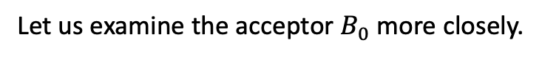
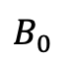
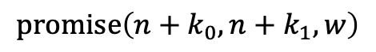
The basics of file systems
Safety (only one value can be chosen)
It seems that we do not forbid the following scenario: a majority $𝔐$ of acceptors accepted a value $(n, v)$ and then some of them accepted $(n+k, w)$ with $k>0$ and $w≠v$.
$$B_{0}$$
Let us examine the acceptor $B_{0}$ more closely.
$$\operatorname{promise}\left(n+k_{0}, n+k_{1}, w\right)$$

Slide 53
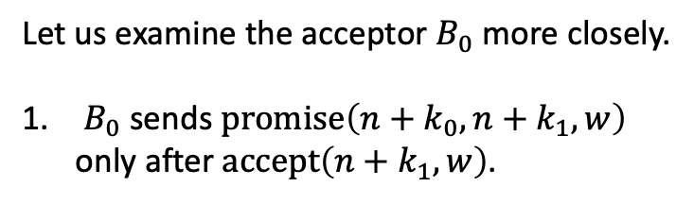
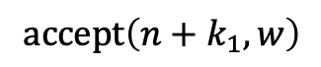
The basics of file systems
Safety (only one value can be chosen)
It seems that we do not forbid the following scenario: a majority $𝔐$ of acceptors accepted a value $(n, v)$ and then some of them accepted $(n+k, w)$ with $k>0$ and $w≠v$.
$$B_{0}$$
Let us examine the acceptor $B_{0}$ more closely.
$B_{0}$ sends $\operatorname{promise}\left(n+k_{0}, n+k_{1}, w\right)$ only after $\operatorname{accept}\left(n+k_{1}, w\right)$.
$$\operatorname{accept}\left(n+k_{1}, w\right)$$
$$\operatorname{promise}\left(n+k_{0}, n+k_{1}, w\right)$$

Slide 54
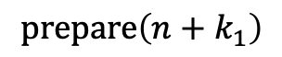
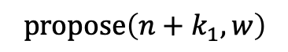
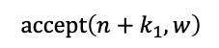
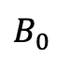
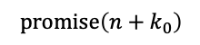
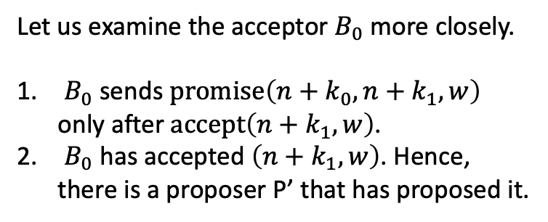
The basics of file systems
Safety (only one value can be chosen)
It seems that we do not forbid the following scenario: a majority $𝔐$ of acceptors accepted a value $(n, v)$ and then some of them accepted $(n+k, w)$ with $k>0$ and $w≠v$.
$$B_{0}$$
P’
Let us examine the acceptor $B_{0}$ more closely.
$B_{0}$ sends $\operatorname{promise}\left(n+k_{0}, n+k_{1}, w\right)$ only after $\operatorname{accept}\left(n+k_{1}, w\right)$.
$B_{0}$ has accepted $\left(n+k_{1},w\right)$. Hence, there is a proposer P’ that has proposed it.
$$\operatorname{prepare}\left(n+k_{1}\right)$$
$$\operatorname{propose}\left(n+k_{1}, w\right)$$
$$\operatorname{accept}\left(n+k_{1}, w\right)$$
$$\operatorname{promise}\left(n+k_{0}\right)$$

Slide 55
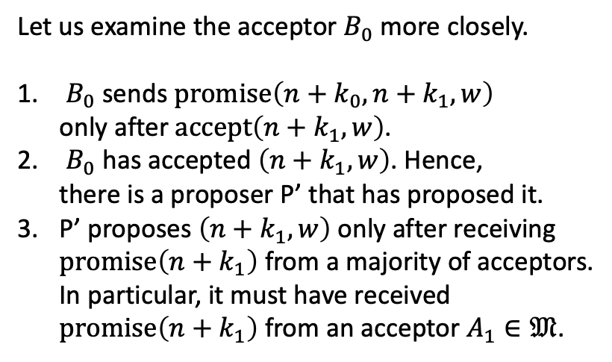
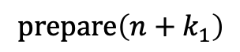


The basics of file systems
Safety (only one value can be chosen)
It seems that we do not forbid the following scenario: a majority $𝔐$ of acceptors accepted a value $(n, v)$ and then some of them accepted $(n+k, w)$ with $k>0$ and $w≠v$.
$$B_{0}$$
P’
$$A_{1}∈𝔐$$
Let us examine the acceptor $B_{0}$ more closely.
$B_{0}$ sends $\operatorname{promise}\left(n+k_{0}, n+k_{1}, w\right)$ only after $\operatorname{accept}\left(n+k_{1}, w\right)$.
$B_{0}$ has accepted $\left(n+k_{1},w\right)$. Hence, there is a proposer P’ that has proposed it.
P’ proposes $\left(n+k_{1},w\right)$ only after receiving $\operatorname{promise}\left(n+k_{1}\right)$ from a majority of acceptors. In particular, it must have received $\operatorname{promise}\left(n+k_{1}\right)$ from an acceptor $A_{1}∈𝔐$.
$$\operatorname{prepare}\left(n+k_{1}\right)$$
$$\operatorname{prepare}\left(n+k_{1}\right)$$
$$\operatorname{promise}\left(n+k_{1}, ?, ?\right)$$
$$\operatorname{propose}\left(n+k_{1}, w\right)$$
$$\operatorname{accept}\left(n+k_{1}, w\right)$$
$$\operatorname{promise}\left(n+k_{0}\right)$$

Slide 56





The basics of file systems
Safety (only one value can be chosen)
It seems that we do not forbid the following scenario: a majority $𝔐$ of acceptors accepted a value $(n, v)$ and then some of them accepted $(n+k, w)$ with $k>0$ and $w≠v$.
$$B_{0}$$
P’
$$A_{1}∈𝔐$$
$$\operatorname{prepare}\left(n+k_{1}\right)$$
$$\operatorname{accept}\left(n, v\right)$$
$$\operatorname{prepare}\left(n+k_{1}\right)$$
$$\operatorname{promise}\left(n+k_{1}, ?, ?\right)$$
How are $accept(n, v)$ and $promise(n+k_{1}, ?,?)$ ordered?
$$\operatorname{accept}\left(n, v\right)$$
$$\operatorname{propose}\left(n+k_{1}, w\right)$$
$$\operatorname{accept}\left(n+k_{1}, w\right)$$
$$\operatorname{promise}\left(n+k_{0}\right)$$

Slide 57



The basics of file systems
Safety (only one value can be chosen)
It seems that we do not forbid the following scenario: a majority $𝔐$ of acceptors accepted a value $(n, v)$ and then some of them accepted $(n+k, w)$ with $k>0$ and $w≠v$.
$$B_{0}$$
P’
$$A_{1}∈𝔐$$
Let us examine the acceptor $B_{0}$ more closely.
$B_{0}$ sends $\operatorname{promise}\left(n+k_{0}, n+k_{1}, w\right)$ only after $\operatorname{accept}\left(n+k_{1}, w\right)$.
$B_{0}$ has accepted $\left(n+k_{1},w\right)$. Hence, there is a proposer P’ that has proposed it.
P’ proposes $\left(n+k_{1},w\right)$ only after receiving $\operatorname{promise}\left(n+k_{1}\right)$ from a majority of acceptors. In particular, it must have received $\operatorname{promise}\left(n+k_{1}\right)$ from an acceptor $A_{1}∈𝔐$.
$$\operatorname{prepare}\left(n+k_{1}\right)$$
$$\operatorname{accept}\left(n, v\right)$$
$$\operatorname{prepare}\left(n+k_{1}\right)$$
$$\operatorname{promise}\left(n+k_{1}, ?, ?\right)$$
$$\operatorname{propose}\left(n+k_{1}, w\right)$$
$$\operatorname{accept}\left(n+k_{1}, w\right)$$
$$\operatorname{promise}\left(n+k_{0}\right)$$

Slide 58


The basics of file systems
Safety (only one value can be chosen)
It seems that we do not forbid the following scenario: a majority $𝔐$ of acceptors accepted a value $(n, v)$ and then some of them accepted $(n+k, w)$ with $k>0$ and $w≠v$.
$$B_{0}$$
P’
$$A_{1}∈𝔐$$
Let us examine the acceptor $B_{0}$ more closely.
$B_{0}$ sends $\operatorname{promise}\left(n+k_{0}, n+k_{1}, w\right)$ only after $\operatorname{accept}\left(n+k_{1}, w\right)$.
$B_{0}$ has accepted $\left(n+k_{1},w\right)$. Hence, there is a proposer P’ that has proposed it.
P’ proposes $\left(n+k_{1},w\right)$ only after receiving $\operatorname{promise}\left(n+k_{1}\right)$ from a majority of acceptors. In particular, it must have received $\operatorname{promise}\left(n+k_{1}\right)$ from an acceptor $A_{1}∈𝔐$.
Recall that $n+k_{0}$ is the minimal epoch when an acceptor in $𝔐$ replies with a value $w≠v$. Thus, $A_{1}$ has replied $\operatorname{promise}\left(n+k_{1}, n, v\right)$.
$$\operatorname{prepare}\left(n+k_{1}\right)$$
$$\operatorname{accept}\left(n, v\right)$$
$$\operatorname{prepare}\left(n+k_{1}\right)$$
$$\operatorname{promise}\left(n+k_{1}, n, v\right)$$
$$\operatorname{propose}\left(n+k_{1}, w\right)$$
$$\operatorname{accept}\left(n+k_{1}, w\right)$$
$$\operatorname{promise}\left(n+k_{0}\right)$$

Slide 59


The basics of file systems
Safety (only one value can be chosen)
It seems that we do not forbid the following scenario: a majority $𝔐$ of acceptors accepted a value $(n, v)$ and then some of them accepted $(n+k, w)$ with $k>0$ and $w≠v$.
$$B_{0}$$
P’
$$A_{1}∈𝔐$$
Let us examine the acceptor $B_{0}$ more closely.
$B_{0}$ sends $\operatorname{promise}\left(n+k_{0}, n+k_{1}, w\right)$ only after $\operatorname{accept}\left(n+k_{1}, w\right)$.
$B_{0}$ has accepted $\left(n+k_{1},w\right)$. Hence, there is a proposer P’ that has proposed it.
P’ proposes $\left(n+k_{1},w\right)$ only after receiving $\operatorname{promise}\left(n+k_{1}\right)$ from a majority of acceptors. In particular, it must have received $\operatorname{promise}\left(n+k_{1}\right)$ from an acceptor $A_{1}∈𝔐$.
$A_{1}$ has replied $\operatorname{promise}\left(n+k_{1}, n, v\right)$.
P’ has received $\operatorname{promise}\left(n+k_{0}, n, v\right)$. What made it send $\operatorname{propose}\left(n+k_{1}, w\right)$?
$$\operatorname{prepare}\left(n+k_{1}\right)$$
$$\operatorname{accept}\left(n, v\right)$$
$$\operatorname{prepare}\left(n+k_{1}\right)$$
$$\operatorname{promise}\left(n+k_{1}, n, v\right)$$
$$\operatorname{propose}\left(n+k_{1}, w\right)$$
$$\operatorname{accept}\left(n+k_{1}, w\right)$$
$$\operatorname{promise}\left(n+k_{0}\right)$$

Slide 60


The basics of file systems
Safety (only one value can be chosen)
It seems that we do not forbid the following scenario: a majority $𝔐$ of acceptors accepted a value $(n, v)$ and then some of them accepted $(n+k, w)$ with $k>0$ and $w≠v$.
$$B_{0}$$
P’
$$A_{1}∈𝔐$$
Let us examine the acceptor $B_{0}$ more closely.
$B_{0}$ sends $\operatorname{promise}\left(n+k_{0}, n+k_{1}, w\right)$ only after $\operatorname{accept}\left(n+k_{1}, w\right)$.
$B_{0}$ has accepted $\left(n+k_{1},w\right)$. Hence, there is a proposer P’ that has proposed it.
P’ proposes $\left(n+k_{1},w\right)$ only after receiving $\operatorname{promise}\left(n+k_{1}\right)$ from a majority of acceptors. In particular, it must have received $\operatorname{promise}\left(n+k_{1}\right)$ from an acceptor $A_{1}∈𝔐$.
$A_{1}$ has replied $\operatorname{promise}\left(n+k_{1}, n, v\right)$.
P’ has received $\operatorname{promise}\left(n+k_{0}, n, v\right)$. What made it send $\operatorname{propose}\left(n+k_{1}, w\right)$? This is only possible if P’ received $\operatorname{promise}\left(n+k_{1}, n+k_{2}, w\right)$ with $n<n+k_{2}<n+k_{1}$.
$$\operatorname{prepare}\left(n+k_{1}\right)$$
$$\operatorname{accept}\left(n, v\right)$$
$$\operatorname{prepare}\left(n+k_{1}\right)$$
$$\operatorname{promise}\left(n+k_{1}, n, v\right)$$
$$\operatorname{promise}\left(n+k_{1}, n+k_{2}, w\right)$$
$$\operatorname{propose}\left(n+k_{1}, w\right)$$
$$\operatorname{accept}\left(n+k_{1}, w\right)$$
$$\operatorname{promise}\left(n+k_{0}\right)$$

Slide 61




The basics of file systems
Safety (only one value can be chosen)
It seems that we do not forbid the following scenario: a majority $𝔐$ of acceptors accepted a value $(n, v)$ and then some of them accepted $(n+k, w)$ with $k>0$ and $w≠v$.
$$B_{0}$$
P’
$$A_{1}∈𝔐$$
There exists the acceptor that sent replies and $\operatorname{accept}\left(n, v\right)$ and $\operatorname{accept}\left(n+k_{0}, w\right)$.
$$⇓$$ There exists an acceptor that sent $\operatorname{promise}\left(n+k_{0}, n+k_{1}, w\right)$ with $n<n+k_{1}<n+k_{0}$.
$$⇓$$
There exists an acceptor that sent $\operatorname{promise}\left(n+k_{1}, n+k_{2}, w\right)$ with $n<n+k_{2}< n+k_{1}<n+k_{0}$. We can keep applying this deduction indefinitely which leads to a contradiction because there only is a finite number of epochs between $n$ and $n+k_{0}$.
$$\operatorname{prepare}\left(n+k_{1}\right)$$
$$\operatorname{accept}\left(n, v\right)$$
$$\operatorname{prepare}\left(n+k_{1}\right)$$
$$\operatorname{promise}\left(n+k_{1}, n, v\right)$$
$$\operatorname{promise}\left(n+k_{1}, n+k_{2}, w\right)$$
$$\operatorname{propose}\left(n+k_{1}, w\right)$$
$$\operatorname{accept}\left(n+k_{1}, w\right)$$
$$\operatorname{promise}\left(n+k_{0}\right)$$

Slide 62









The basics of file systems
Safety (only one value can be chosen)
It seems that we do not forbid the following scenario: a majority $𝔐$ of acceptors accepted a value $(n, v)$ and then some of them accepted $(n+k, w)$ with $k>0$ and $w≠v$.
$$B_{0}$$
P’
$$A_{1}∈𝔐$$
There exists the acceptor that sent replies and $\operatorname{accept}\left(n, v\right)$ and $\operatorname{accept}\left(n+k_{0}, w\right)$.
$$⇓$$ There exists an acceptor that sent $\operatorname{promise}\left(n+k_{0}, n+k_{1}, w\right)$ with $n<n+k_{1}<n+k_{0}$.
$$⇓$$
There exists an acceptor that sent $\operatorname{promise}\left(n+k_{1}, n+k_{2}, w\right)$ with $n<n+k_{2}< n+k_{1}<n+k_{0}$. We can keep applying this deduction indefinitely which leads to a contradiction because there only is a finite number of epochs between $n$ and $n+k_{0}$.
$$\operatorname{prepare}\left(n+k_{1}\right)$$
$$\operatorname{accept}\left(n, v\right)$$
$$\operatorname{prepare}\left(n+k_{1}\right)$$
$$\operatorname{promise}\left(n+k_{1}, n, v\right)$$
$$\operatorname{promise}\left(n+k_{1}, n+k_{2}, w\right)$$
$$\operatorname{propose}\left(n+k_{1}, w\right)$$
$$\operatorname{accept}\left(n+k_{1}, w\right)$$
$$\operatorname{promise}\left(n+k_{0}\right)$$

Slide 63

The basics of file systems
Safety (only one value can be chosen)
It seems that we do not forbid the following scenario: a majority $𝔐$ of acceptors accepted a value $(n, v)$ and then some of them accepted $(n+k, w)$ with $k>0$ and $w≠v$.
$$B_{0}$$
P’
$$A_{1}∈𝔐$$
There exists the acceptor that sent replies and $\operatorname{accept}\left(n, v\right)$ and $\operatorname{accept}\left(n+k_{0}, w\right)$.
$$⇓$$ There exists an acceptor that sent $\operatorname{promise}\left(n+k_{0}, n+k_{1}, w\right)$ with $n<n+k_{1}<n+k_{0}$.
$$⇓$$
There exists an acceptor that sent $\operatorname{promise}\left(n+k_{1}, n+k_{2}, w\right)$ with $n<n+k_{2}< n+k_{1}<n+k_{0}$. We can keep applying this deduction indefinitely which leads to a contradiction because there only is a finite number of epochs between $n$ and $n+k_{0}$.
$$⇓$$
If an acceptor replied $\operatorname{accept}\left(n, v\right)$, it can no longer reply $\operatorname{accept}\left(n+k_{0}, w\right)$.
$$\operatorname{prepare}\left(n+k_{1}\right)$$
$$\operatorname{accept}\left(n, v\right)$$
$$\operatorname{prepare}\left(n+k_{1}\right)$$
$$\operatorname{promise}\left(n+k_{1}, n, v\right)$$
$$\operatorname{promise}\left(n+k_{1}, n+k_{2}, w\right)$$
$$\operatorname{propose}\left(n+k_{1}, w\right)$$
$$\operatorname{accept}\left(n+k_{1}, w\right)$$
$$\operatorname{promise}\left(n+k_{0}\right)$$

Slide 64



The basics of file systems
Liveness
PAXOS guarantees safety (at most one value is chosen). Does it guarantee liveness (a value is chosen)?
P₀
A
P₁
$$\operatorname{prepare}\left(0\right)$$
$$\operatorname{promise}\left(0\right)$$
$$\operatorname{propose}\left(0, v\right)$$

Slide 65


The basics of file systems
Liveness
PAXOS guarantees safety (at most one value is chosen). Does it guarantee liveness (a value is chosen)?
P₀
A
P₁
$$\operatorname{prepare}\left(0\right)$$
$$\operatorname{promise}\left(0\right)$$
$$\operatorname{prepare}\left(1\right)$$
$$\operatorname{promise}\left(1\right)$$
$$\operatorname{propose}\left(0, v\right)$$

Slide 66
The basics of file systems
Liveness
PAXOS guarantees safety (at most one value is chosen). Does it guarantee liveness (a value is chosen)?
P₀
A
P₁
$$\operatorname{prepare}\left(0\right)$$
$$\operatorname{promise}\left(0\right)$$
$$\operatorname{prepare}\left(1\right)$$
$$\operatorname{promise}\left(1\right)$$
$$\operatorname{propose}\left(0, v\right)$$
NACK

Slide 67


The basics of file systems
Liveness
PAXOS guarantees safety (at most one value is chosen). Does it guarantee liveness (a value is chosen)?
P₀
A
P₁
$$\operatorname{prepare}\left(0\right)$$
$$\operatorname{promise}\left(0\right)$$
$$\operatorname{prepare}\left(1\right)$$
$$\operatorname{promise}\left(1\right)$$
$$\operatorname{propose}\left(0, v\right)$$
NACK
$$\operatorname{prepare}\left(2\right)$$
$$\operatorname{promise}\left(2\right)$$

Slide 68

The basics of file systems
Liveness
PAXOS guarantees safety (at most one value is chosen). Does it guarantee liveness (a value is chosen)?
P₀
A
P₁
Proposers P₀ and P₁ can keep interfering one with the other indefinitely long.
$$\operatorname{prepare}\left(0\right)$$
$$\operatorname{promise}\left(0\right)$$
$$\operatorname{prepare}\left(1\right)$$
$$\operatorname{promise}\left(1\right)$$
$$\operatorname{propose}\left(0, v\right)$$
NACK
$$\operatorname{prepare}\left(2\right)$$
$$\operatorname{promise}\left(2\right)$$
$$\operatorname{propose}\left(1, u\right)$$
NACK

Slide 69
The basics of file systems
Liveness
PAXOS guarantees safety (at most one value is chosen). Does it guarantee liveness (a value is chosen)?
P₀
A
P₁
Proposers P₀ and P₁ can keep interfering one with the other indefinitely long.
Fischer, Lynch, Paterson: Impossibility of distributed consensus with one faulty process.
$$\operatorname{prepare}\left(0\right)$$
$$\operatorname{promise}\left(0\right)$$
$$\operatorname{prepare}\left(1\right)$$
$$\operatorname{promise}\left(1\right)$$
$$\operatorname{propose}\left(0, v\right)$$
NACK
$$\operatorname{prepare}\left(2\right)$$
$$\operatorname{promise}\left(2\right)$$
$$\operatorname{propose}\left(1, u\right)$$
NACK

Slide 70
The basics of file systems
Liveness
PAXOS guarantees safety (at most one value is chosen). Does it guarantee liveness (a value is chosen)?
P₀
A
P₁
Proposers P₀ and P₁ can keep interfering one with the other indefinitely long.
Fischer, Lynch, Paterson: Impossibility of distributed consensus with one faulty process. In practice, this problem can be solved by electing one process to issue all proposals.
The election can be made sufficiently reliable by adding random delays to candidate proposals.
Cf. jitter in exponential backoffs.
$$\operatorname{prepare}\left(0\right)$$
$$\operatorname{promise}\left(0\right)$$
$$\operatorname{prepare}\left(1\right)$$
$$\operatorname{promise}\left(1\right)$$
$$\operatorname{propose}\left(0, v\right)$$
NACK
$$\operatorname{prepare}\left(2\right)$$
$$\operatorname{promise}\left(2\right)$$
$$\operatorname{propose}\left(1, u\right)$$
NACK

Slide 71
The basics of file systems
Wrong ways to handle FS corruption
The paper [1] ran an experiment where the data of the following applications was located on a file system that would randomly corrupt the content of blocks: Redis, ZooKeeper, Cassandra, Kafka, RethinkDB, LogCabin. [1] https://www.usenix.org/system/files/conference/fast17/fast17-ganesan.pdf [2] https://www.usenix.org/system/files/conference/fast18/fast18-alagappan.pdf

Slide 72
The basics of file systems
Wrong ways to handle FS corruption
The paper [1] ran an experiment where the data of the following applications was located on a file system that would randomly corrupt the content of blocks: Redis, Does not validate checksums of user data, Replicates corrupted data across nodes of a cluster, Corruptions of a FS are “handled” with assert()s. ZooKeeper, Cassandra, Has no checksums for uncompressed data, When the checksum does not match, Cassandra chooses the last write as “the correct one”. This way it can replicate corrupted data to other cluster nodes. Kafka, RethinkDB, LogCabin. [1] https://www.usenix.org/system/files/conference/fast17/fast17-ganesan.pdf [2] https://www.usenix.org/system/files/conference/fast18/fast18-alagappan.pdf

Slide 73
The basics of file systems
Wrong ways to handle FS corruption
The paper [1] ran an experiment where the data of the following applications was located on a file system that would randomly corrupt the content of blocks: Redis, Does not validate checksums of user data, Replicates corrupted data across nodes of a cluster, Corruptions of a FS are “handled” with assert()s. ZooKeeper, Cassandra, Has no checksums for uncompressed data, When the checksum does not match, Cassandra chooses the last write as “the correct one”. This way it can replicate corrupted data to other cluster nodes. Kafka, RethinkDB, LogCabin. Mistakes in Redis and Cassandra highlight the importance of the model of faults that PAXOS protects from. PAXOS assumes fail-stop participants and a network that does not corrupt messages. [1] https://www.usenix.org/system/files/conference/fast17/fast17-ganesan.pdf [2] https://www.usenix.org/system/files/conference/fast18/fast18-alagappan.pdf

Slide 74
The basics of file systems
PAXOS made live
Participants must adhere to PAXOS even if their RAM or disks have corruption.

Slide 75

The basics of file systems
PAXOS made live
Participants must adhere to PAXOS even if their RAM or disks have corruption. Master leases: Most of the load on distributed key-value storages comes from read requests. We want to serve such requests by plain reads from one node, without reaching consensus ”the result of read $\#i$ is $x$”.

Slide 76

The basics of file systems
PAXOS made live
Participants must adhere to PAXOS even if their RAM or disks have corruption. Master leases: Most of the load on distributed key-value storages comes from read requests. We want to serve such requests by plain reads from one node, without reaching consensus ”the result of read $\#i$ is $x$”. There must be a way to add and delete cluster nodes.

Slide 77

The basics of file systems
PAXOS made live
Participants must adhere to PAXOS even if their RAM or disks have corruption. Master leases: Most of the load on distributed key-value storages comes from read requests. We want to serve such requests by plain reads from one node, without reaching consensus ”the result of read $\#i$ is $x$”. There must be a way to add and delete cluster nodes. The FSM log cannot grow infinitely long. Periodically, one must make snapshots of the FSM and truncate the journal.

Slide 78
The basics of file systems
To read
Distributed consensus revised. https://www.cl.cam.ac.uk/techreports/UCAM-CL-TR-935.pdf PAXOS made live. https://www.cs.utexas.edu/users/lorenzo/corsi/cs380d/papers/paper2-1.pdf

